Slide 1
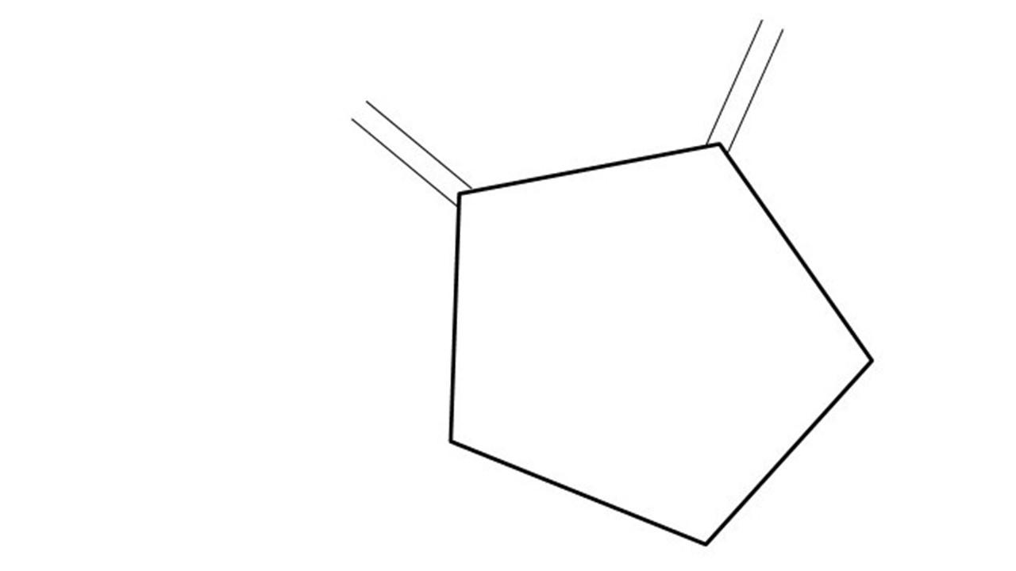
Great Cow BASIC Part 17
Great Cow BASIC for the PIC16F171xx chip Family
October 2022

Slide 2
Videos...
Install the hardware and make the board work – three LED programs
Make four LEDs flash in a sequence
Set the LEDs to represent the value of ADC
Sequence the LEDs with a delay using the value of ADC
Using an input to set the state of the LED
Using the reset switch
Using the switch, ADC – the LEDs flash in a sequence with reverse
Using the serial to display values
Using the timer0 overflow, 8bit timer, 16bit timer to flash the LEDs
Using CCP/PWM to dim the LEDS
Using I²C with serial to discover I2C devices
Using EEProm – showing values on the serial terminal
Using an I²C GCLD display
Using an SPI GCLD display
Using PWM to dim the LEDS
Using memory within the PIC – Progmem and SAF memory
The Great Cow BASIC tool chain
Assembly and alternatives assemblers
Summary

Slide 3
Great Cow BASIC Compiler
Great Cow BASIC is an Open Source compiler for Microchip PIC &AVR and Logic Green AVR microcontrollers
Great Cow BASIC now supports the 16F171xx chip family
Great Cow BASIC Compiler

Slide 4
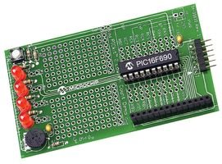
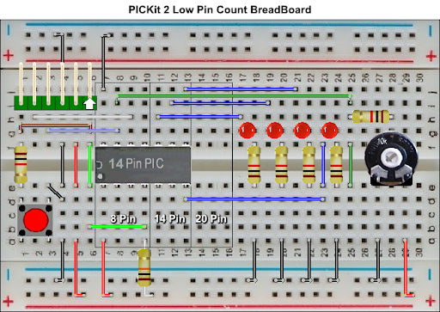

Hardware
Microchip Low Pin Count Demo Board
PICKit_2_Low_Pin_Count_User_Guide_51556a.pdf
By Chris Roper

Slide 5
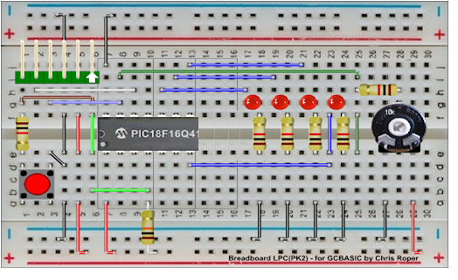
Hardware
GND
Layout
16F17126
By Chris Roper
TX on PORTC.4

Slide 6
The compiler
High Level Language
Reports:
TXT and HTML
Source Code
Great Cow BASIC Compiler
Great Cow BASIC Compiler
Preprocessor
Code Translator
Assembler
Linker
Assembly Language
ASM file
Absolute Machine Code
HEX file
Libraries
8 bit PIC, AVR and LGT

Slide 7
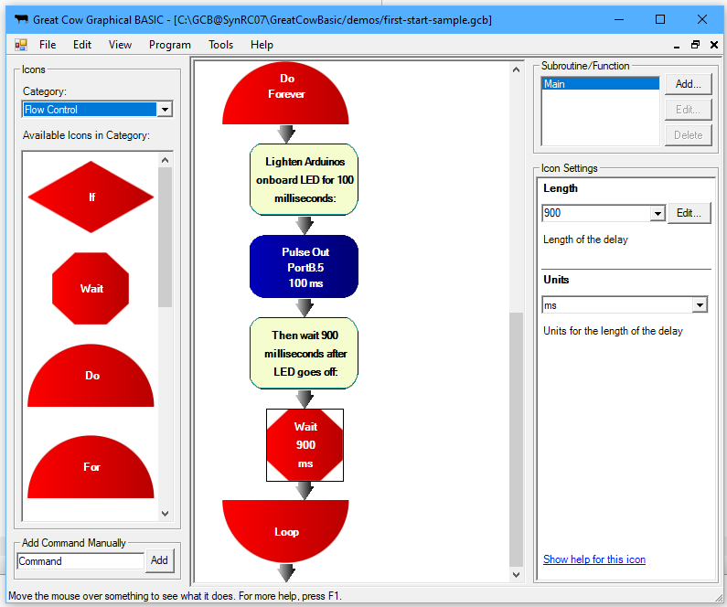
Great Cow Graphical BASIC - GCGB
PPSTool
CLC
Great Cow Graphical BASIC
Great Cow BASIC Compiler
Programmers
PSMC

Slide 8
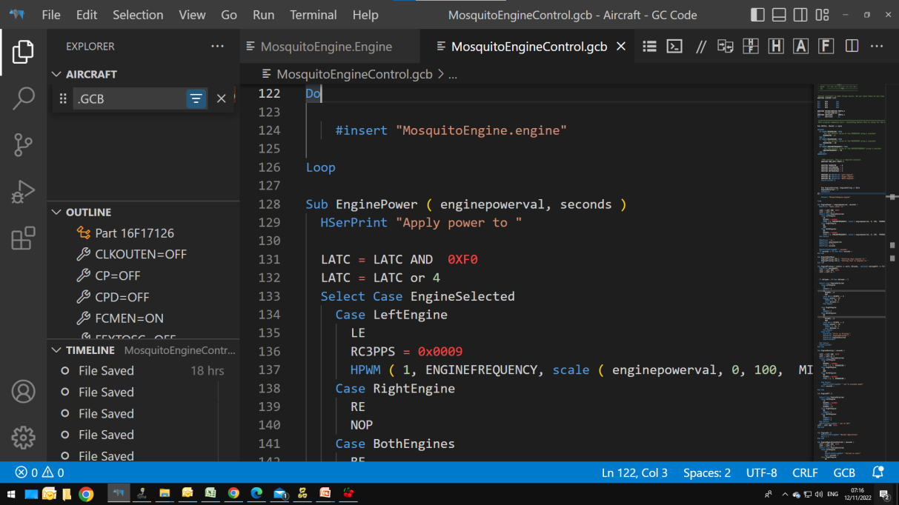
The Windows IDE
PPSTool
CLC
PicInfo
PSMC
GCStudio
Great Cow BASIC Compiler
Programmers
GCode Editor
Program Editor
Terminal
GCStudio
- manages the update process
- supports SynWrite or Geany

Slide 9
Tool chain
INDEX | APPLICATION TITLE | CLASS | SEEN | MAINTAINED
1 | AVRDude | Programmer | N | http://savannah.nongnu.org\projects\avrdude
2 | CLC Designer | Code Generator | Y | No
3 | Converters | Converter | Y | Yes by Great Cow BASIC team
4 | CoolTerm | Terminal | N | Yes, see website
5 | DFU Bootloader | Programmer | N | Anobium..GITHub
6 | G+Stool | IDE | N | Deprecated - Yes by Great Cow BASIC team
7 | GCStudio and Gcode | IDE | Y | Yes by Great Cow BASIC team based on VSCode
8 | Great Cow BASIC compiler | Compiler | Y | Yes by Great Cow BASIC team
9 | Great Cow Graphical BASIC IDE | IDE | N | Yes by Great Cow BASIC team
10 | K150 | Programmer | N | http://www.kitsrus.com/pic.html
11 | Micronucleus | Programmer | N | Micronucleus..GitHub
12 | MPLAB_IPE | Programmer | N | https://www.microchip.com/mplab/mplab-x-ide
13 | Northern Software | Programmer | N | https://www.northernsoftware.com/
14 | PICInfo | Code Generator | Y | Yes by Great Cow BASIC team
15 | PicKit2 command line – for older chips | Programmer | N | Microchip website
16 | PicKit2 GUI – for older chips | Programmer | N | Microchip website
17 | PicKit3 GUI – for older chips | Programmer | N | Microchip Website
18 | PicKit3 MPLAB-IPE integration tool | Programmer | N | http://www.autoitscript.com
19 | PICKitPlus – PICkit2 and PICKit3 suite | Programmer | Y | www.pickitplus.co.uk
20 | PICPgm | Programmer | N | http://picpgm.picprojects.net/
21 | PPS Tool | Code Generator | Y | Yes by Great Cow BASIC team
22 | Programmer editor | IDE | Y | Yes by Great Cow BASIC team
23 | PSMC Designer | Code Generator | N | No
24 | Putty | Terminal | N | Yes, see website
25 | SynWrite IDE | IDE | N | Deprecated - Yes by Great Cow BASIC team
26 | Terminal | Terminal | Y | Yes, see website
27 | TinyBootLoader | Programmer | N | http://tinypicbootload.sourceforge.net/
28 | XpressLoader for Microchip Xpress boards | Programmer | N | https://sourceforge.net/p/gcbasic/code/HEAD/tree/utils/

Slide 10
Compiler options
High Level Language
Reports:
TXT and HTML
Outputs:
many….
Source Code
PIC-AS, MPASM,
MPLAB-IDE,
GPASM, etc
Great Cow BASIC Compiler
Great Cow BASIC Compiler
Preprocessor
Code Translator
Assembler
Linker
Assembly Language
file
Absolute Machine Code
HEX file
Libraries
8 bit PIC, AVR and LGT

Slide 11
The Variants for Linux, BSD & Mac
$ time LC_ALL=C /opt/GCBASIC/makehex.sh code9.gcb Great Cow BASIC (0.98.07 RC07 2020-04-01 (Linux 64 bit)) Compiling code9.gcb ... Done Assembling program ... Program assembled successfully! real 0m2,947s user 0m2,886s sys 0m0,045s
An Editor
Great Cow BASIC Compiler
Programmers
Scripts

Slide 12
Lab
We will
Review GCStudio
Review PICINFO
Review PPSTool
Edit Preferences and code portability
Review CLCTool and usage

Slide 13
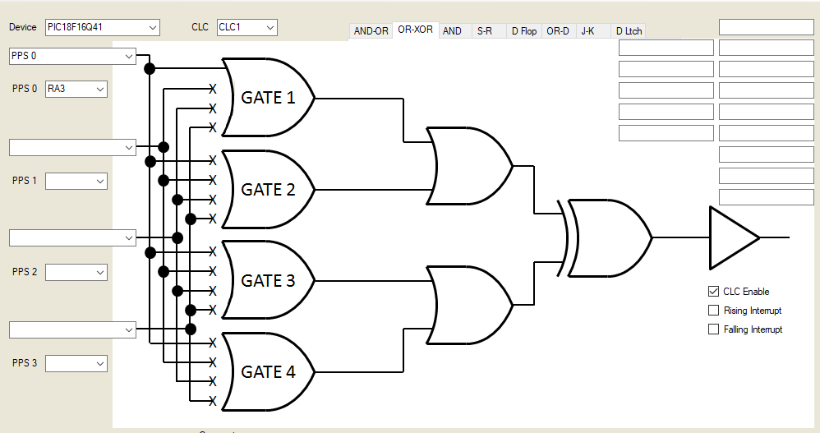
Lab
Configurable Logic Cell on PIC MCUs
The CLC has a variety of basic gates as well as sequential logic options that can be customised to create the logic specific to your application.
Through these logic gates, the CLC gives you the ability to combine signals to make a new custom signal without running code to execute it.
Example – switch to LEDs with no cpu code
We will
Review PICINFO
Review PPSTool
Edit Preferences and code portability
Review CLCTool(s) and usage

Slide 14
Tool chain

Slide 15
Videos...
Install the hardware and make the board work – three LED programs
Make four LEDs flash in a sequence
Set the LEDs to represent the value of ADC
Sequence the LEDs with a delay using the value of ADC
Using an input to set the state of the LEDs
Using the reset switch
Using the switch, ADC – the LEDs flash in a sequence with reverse
Using the serial to display values
Using the timer0 overflow, 8bit timer, 16bit timer to flash the LEDs
Using CCP/PWM to dim the LEDS
Using I2C with serial to discover I2C devices
Using EEProm – showing values on the serial terminal
Using an I2C GCLD display
Using an SPI GCLD display
Using PWM to dim the LEDS
Using memory within the PIC – Progmem and SAF memory
The Great Cow BASIC tool chain
Assembly and alternatives assemblers
Summary

Slide 16
Great Cow BASIC Part 17
Great Cow BASIC for the PIC16F171xx chip Family
October 2022

Slide 18
Backup Slides

Slide 19
Great Cow BASIC – PIC, AVR and LGT
High Level Language
Reports:
TXT and HTML
Source Code
Great Cow BASIC Compiler
Great Cow BASIC Compiler
Preprocessor
Code Translator
Assembler
Linker
Assembly Language
ASM file
Absolute Machine Code
HEX file
Libraries
8 bit PIC, AVR and LGT

